Slide 1
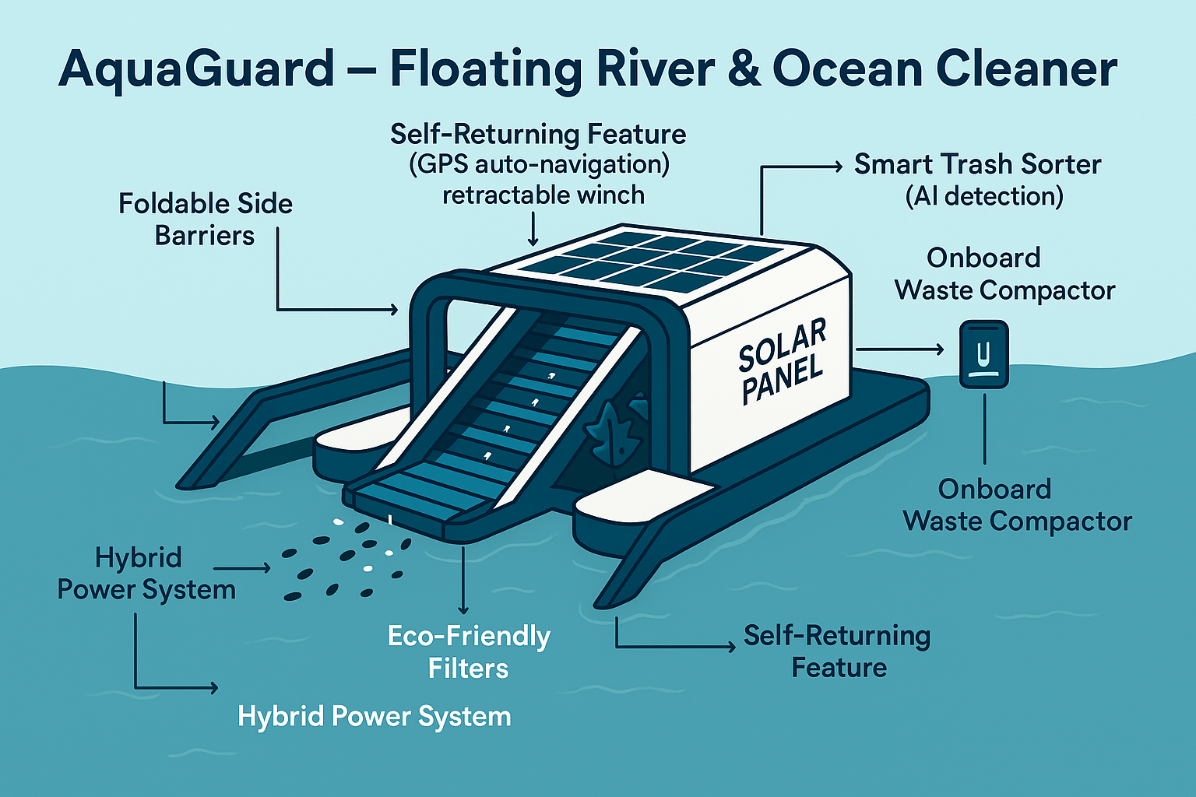
INNOVATION AND SUSTAINABILITY IN COASTAL AREAS

Slide 2
Problem Identification
Every year, over 11 million metric tons of plastic waste enter the ocean, and up to 80% of it comes from rivers.
Floating waste clogs waterways, harms marine animals, and breaks down into microplastics that contaminate the food chain.
Current cleanup solutions are slow, labor-intensive, and fuel-powered, making them costly and environmentally unsustainable.
Collected waste often fills boats quickly, forcing frequent trips to shore, which increases operational costs and reduces cleanup efficiency.

Slide 3
Background for getting the idea/innovation
Who it is for?
Coastal towns, riverfront cities, ports, and environmental NGOs.
What will it do?
Autonomous Cleanup – Patrols rivers, harbors, or coasts using GPS, guiding waste in with foldable barriers
Microplastic Filtration – Cleans return water by capturing harmful microplastics safely.
Onboard Compaction – Compresses collected waste to maximize storage and reduce offloading trips.
Renewable Operation – Runs entirely on solar power with tidal/battery backup, returning to dock automatically when full or low on power.

Slide 4
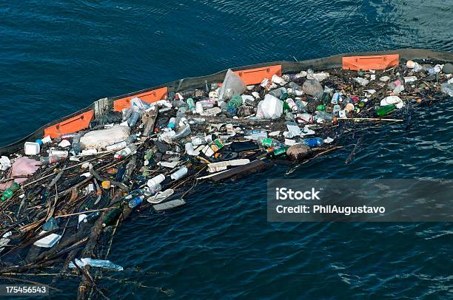

Slide 5
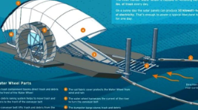
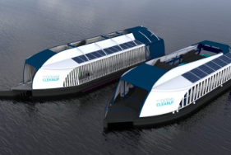
Newness/uniqueness of the innovation
Trash Trapping Module
Extended arms or net structure
Guides floating trash toward the intake
Trash Gathering Module
Conveyor belt or suction mechanism
Transfers debris into the trash container
Potential Enhancements
Solar-powered operation
AI-based obstacle detection
Modular storage bins
GPS tracking and remote monitoring
Real-time pollution data reporting
Dual-Stage Cleaning
Removes both large waste and microplastics from water.

Slide 6
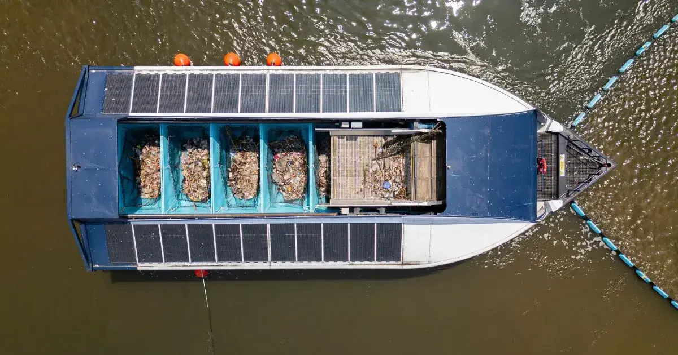

Slide 7
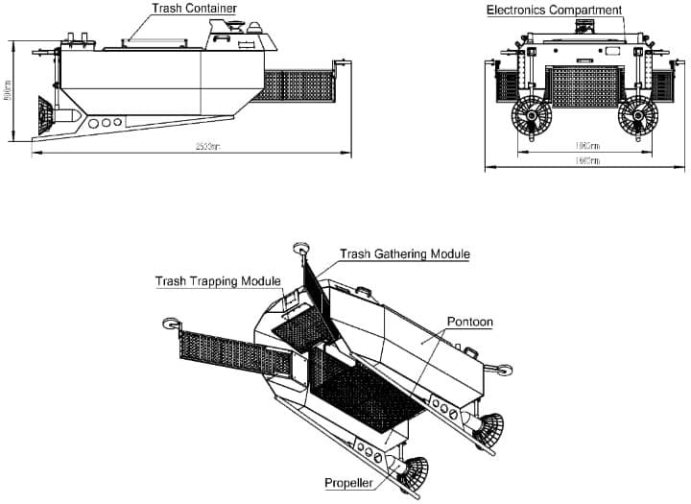
Objective(s) of the idea/innovation
Major Components
Trash Container
Stores collected debris
Large capacity for extended operation
Electronics Compartment
Contains sensors, controllers, batteries
Enables autonomous navigation
Propulsion System
Twin propellers for movement and steering
System Dimensions
Overall Length: ~253 cm
Overall Width: ~196 cm
Height: ~87 cm
Compact Size: Allows operation in narrow water channels

Slide 8
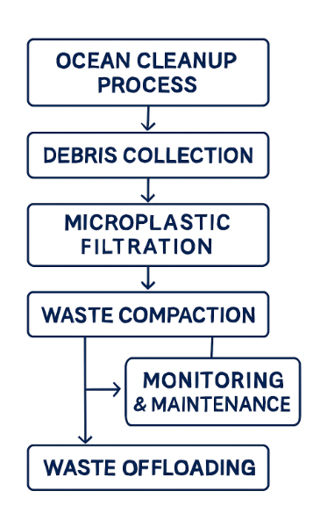
Potential areas of application in industry/market in brief
Port Authorities
Keeping harbors and docking zones free from floating waste.
Tourism & Coastal Resorts
Maintaining clean beaches and clear waters for visitors.
Municipal Waterways
Cleaning rivers, lakes, and canals in urban areas.
Marine Conservation Groups
Supporting environmental cleanup missions.
Fishing & Aquaculture Industry
Protecting aquatic ecosystems from plastic pollution.

Slide 9
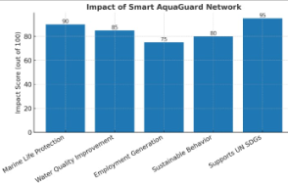
Market data for the potential idea/ innovation
Recycled Ocean Plastics Market
Rapid growth driven by rising awareness and infrastructure investments.
Asia-Pacific dominates, backed by stringent sustainability initiatives and industrial expansion.
Market Trend | Insight for AquaGuard

Slide 10
Current development status of idea/innovation by applicant/incubatee
Concept Stage with Initial Design Blueprint — Core features, functional modules, and operating principles defined.
3D Model & Flowchart Completed — System layout, waste collection mechanism, and energy source integration visualized.
Component Feasibility Check Done — Identified readily available parts (solar panels, GPS, waste compactor, microplastic filter) for prototype build.
Basic Navigation Algorithm Prepared — Preliminary path-planning logic for autonomous patrol routes in calm waters.
Market Research Conducted — Verified demand in ports, coastal cities, and private marinas.
Ready for Prototype Build — Next step is assembly and field testing in small-scale marine conditions.

Slide 11
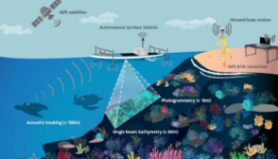
Literature Survey/Prior art on the concept, if any
Microplastic capture / filtration —
Studies on membrane filters, coagulation/flocculation pre-treatment, and
novel passive collectors for sub-millimeter particles. Autonomous Surface Vehicles (ASVs) — Papers on navigation, path planning, collision avoidance
directly relevant for self-patrol + return features.

Slide 12

Solution Proposed (with Block diagram/ 3D Model/ flow chart/ Circuit Diagram / Pictures)

Slide 13
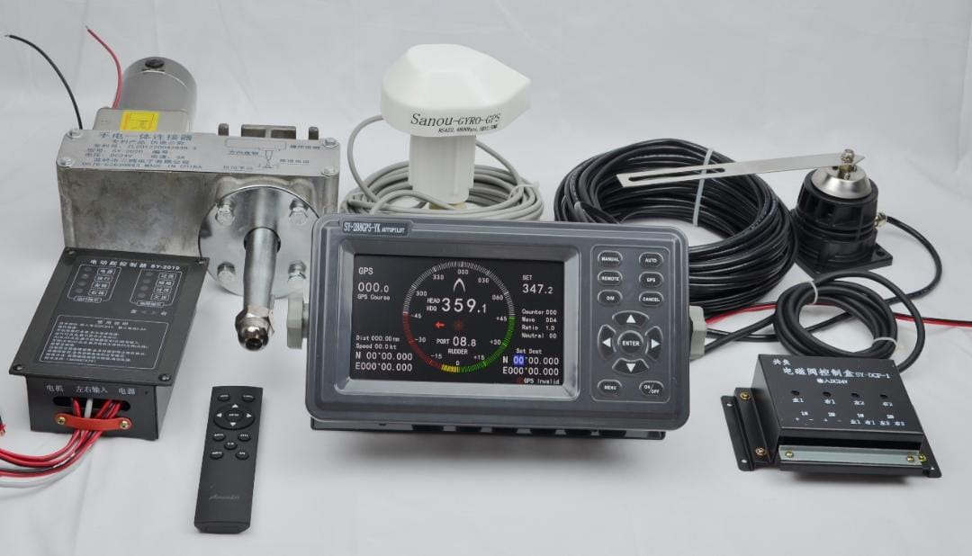
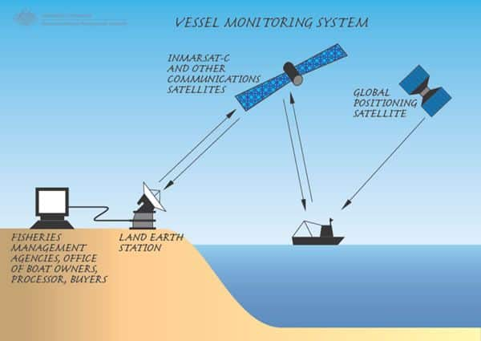
Solution Proposed (with Block diagram/ 3D Model/ flow chart/ Circuit Diagram / Pictures)
Remote Tracking & GPS Integration
Equipped with a GPS module for real-time location tracking
Tracks the robot's position on a live map interface via mobile or web app
Remote access through Wi-Fi, 4G/5G, or LoRa communication modules
Precise geolocation helps monitor cleaning routes and progress
Enables route planning and geofencing to clean specific zones
Receives automated navigation commands from a central control system
Triggers alerts if the robot deviates from assigned cleaning area
Stores historical path data for performance analytics and optimization
Emergency override feature to stop or redirect the robot remotely

Slide 14
How you actually make, assemble, synthesize, or build the solution?
Mechanical Assembly
Hull: Lightweight corrosion-resistant materials (HDPE or marine-grade aluminum).
Barriers: Retractable arms with netting or conveyor-belt system to collect debris.
Waste Compactor: Onboard compression unit to reduce storage volume.
. Power & Energy Integration
Solar Panels: Mounted on top deck, connected to LiFePO₄ battery bank.
Backup: Tidal generator or shore-based charging dock for low-light days

Slide 15
How simple or complex will the idea’s execution or implementation be? What are the risk factors involved in executing the idea?
Marine Environment Challenges
Saltwater corrosion on metal parts.
High wave conditions affecting stability.
Navigation & Obstacle Avoidance
Collisions with boats, buoys, or marine animals if sensors fail.
Power Reliability
Solar efficiency drops in cloudy or stormy conditions, risking mission failure without backup.
Maintenance & Biofouling
Barnacle growth and debris clogging can reduce efficiency and require frequent servicing.
Waste Disposal Logistics
Need reliable shore infrastructure to handle collected waste and recycling.
Regulatory Compliance
Must meet maritime regulations, environmental permits, and coastal authority approvals.

Slide 16
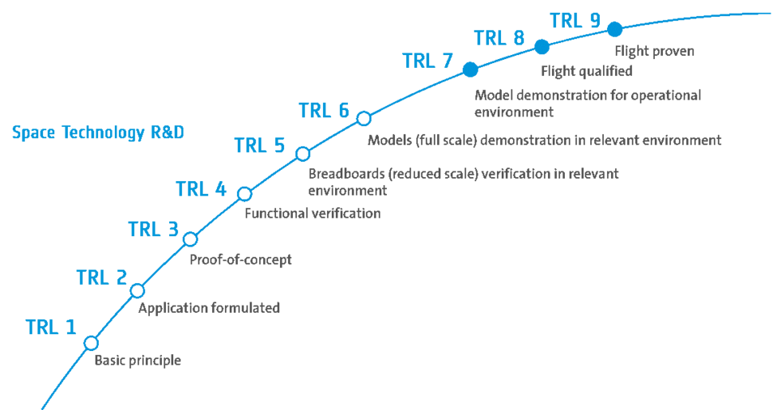
How soon could the idea be put into operation? (TRL of prototype)
Current Stage – TRL 4 or TRL 5
Why:
You have a clear proof-of-concept: an autonomous vessel with GPS navigation, waste funneling, microplastic filtering, and renewable energy power.
The concept can be functionally verified in lab/small-scale testing (e.g., in a pond, swimming pool, or small harbor simulation).
If you already have a working prototype tested in controlled water, you’re entering TRL 5 (breadboard/prototype in a relevant environment).
Indicated your project TRL

Slide 17
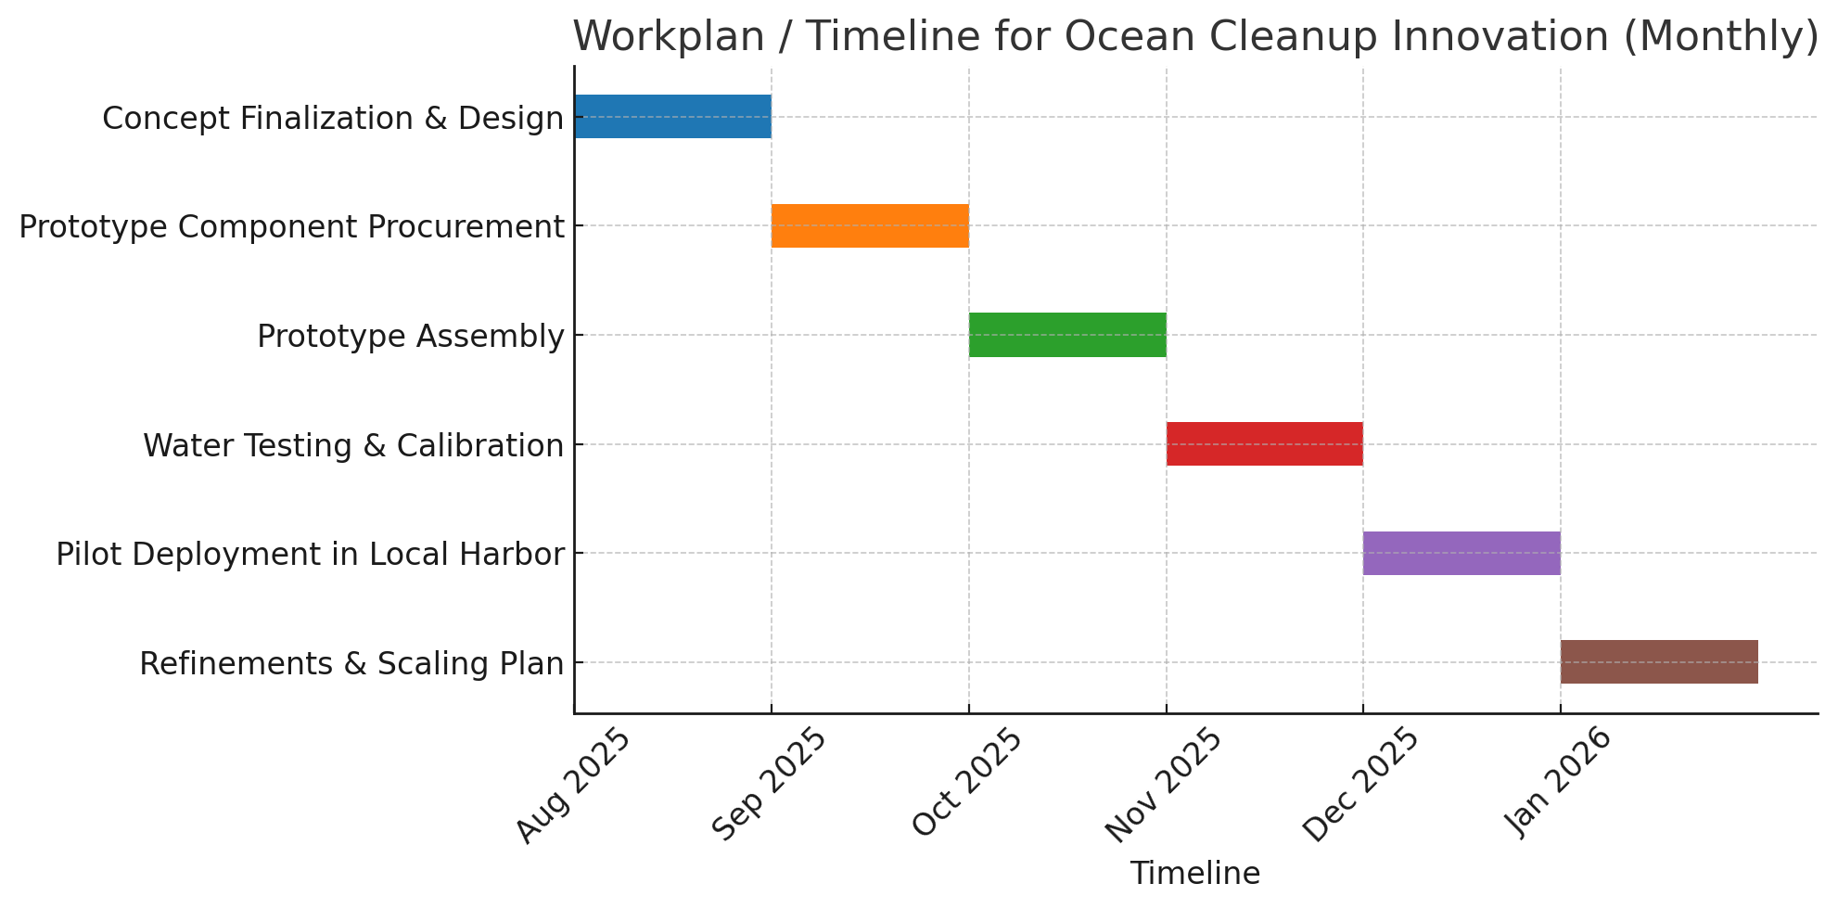
Workplan/Timeline (Monthlywise – Chart)

Slide 18
Technology related Expenditure
Technology related Expenditure towards machine usage charges etc., Electricity charges, Procurement of raw material , testing/Calibration charges, other charges essential for development of idea. Max (10.00) lakh.
Sl.No. | Particular/Item/Specification | Quantity (No.s) | Rate (Rs./No.) | Amount (Rs.)
1 | Procurement of Raw Materials & Components (Solar panels, wind turbine kits, sensors, batteries) | 5 | 70,000 | 3,50,000
2 | Machinery Usage Charges (CNC cutting, fabrication, assembly tools) | 2 | 50,000 | 1,00,000
3 | Testing & Calibration Charges (Lab and field equipment testing, environmental simulations) | 3 | 50,000 | 1,50,000
4 | Software Development (Control system, monitoring dashboard,optimization,algorithms) | 2 | 60,000 | 1,20,000

Slide 19
Technology related Expenditure
Technology related Expenditure towards machine usage charges etc., Electricity charges, Procurement of raw material , testing/Calibration charges, other charges essential for development of idea. Max (10.00) lakh.
Sl.No. | Particular/Item/Specification | Quantity (No.s) | Rate (Rs./No.) | Amount (Rs.)
5 | Electricity & Utility Charges (during prototype building and testing phases) | 1 | 50,000 | 50,000
6 | Field Deployment & Transportation (to coastal sites) | 2 | 20,000 | 40,000
7 | Documentation, Reporting, and Contingency | 2 | 40,000 | 80,000
8 | GPS Receiver/Device, Satellite Network, Communication Network, Server/Cloud Platform | 4 | 10,000 | 40,000
 |  |  |  | 930,000
Total. Max (10.00) lakh. |  |  |  | 930,000

Slide 20
Financial requirements (activity-wise break-up)
Particular/Item | Total idea project cost (Rs.) | Amount GOI assistance (Rs.) | Incubatee share (Rs.) (Nil for Students/ 15% for others/ entrepreneurs / MSMEs)
Technology related Expenditure towards machine usage charges etc., Electricity charges, Procurement of raw material , testing/Calibration charges, other charges essential for development of idea. Max (10.00) lakh. | 10,00,000 | 10,00,000 | 1,50,000
Charges for mentor/handholding supporting team. Max (3.00) lakh. | 3,00,000 | 3,00,000 | 45,000
Travelling Expenses or any other item not covered as above may be allowed as per need for development of the idea. Max ( 2.00) lakh. | 2,00,000 | 2,00,000 | 30,000
Total. Max (15.00) lakh.

Slide 21
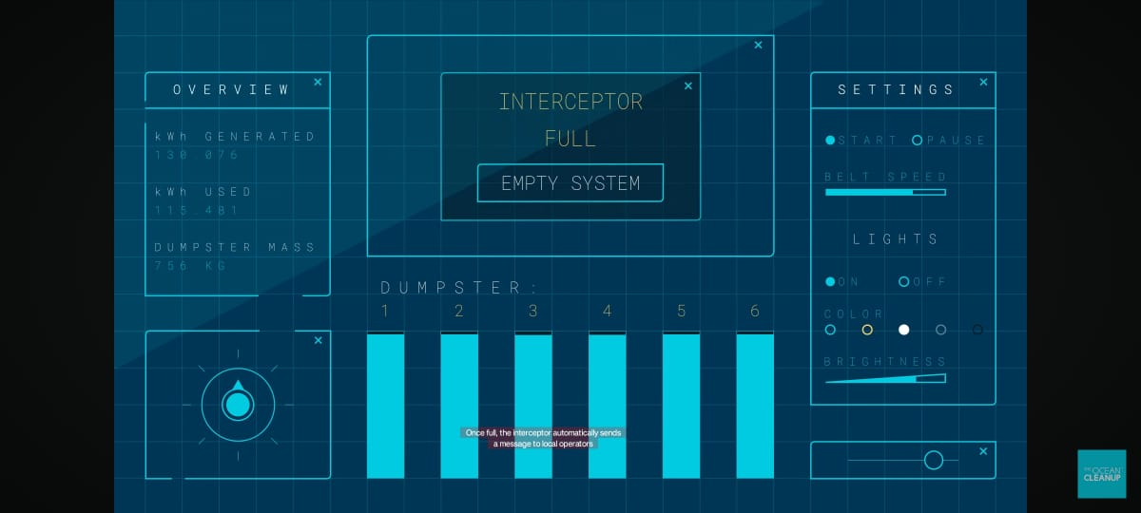
Whether the idea involves use of existing intellectual property or not, give brief detail there of / Patenting Possibility
Risk & Opportunities in IP
Risk: Potential overlap with mechanical collection methods already patented.
Opportunity: Patent around integration, automation logic, energy system design, and compact mechanical arrangements.
Bonus: Open-source certain non-core components to attract collaborators while keeping critical IP proprietary.

